Slide 1



Fluorescence and fluorescence-lifetime imaging microscopy (FLIM) to characterize yeast strains by autofluorescence
H. Bhattaª, E.M. Goldysª and J. Ma^{b}
ªDepartment of Physics, ^{b}Department of Statistics
Macquarie University - Sydney, Australia

Slide 2
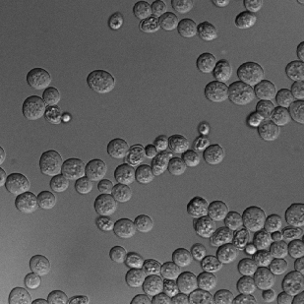
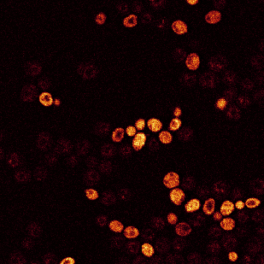
Problem: Quantiative indicators in the presence of heterogeneity
Diversity within microbial population
  Size, fluorescence intensity, texture
Solution: Characterise populations

Slide 3
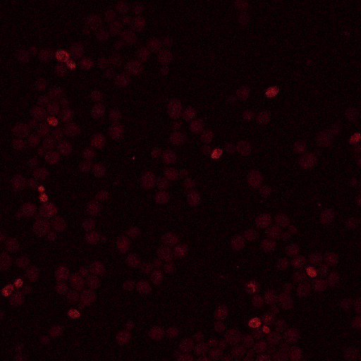
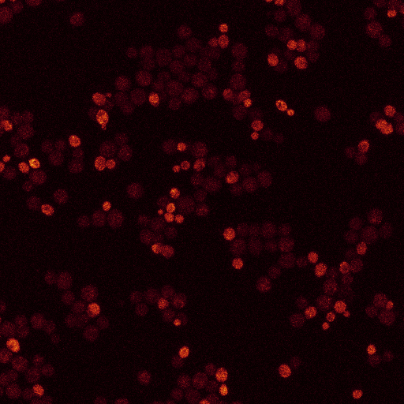
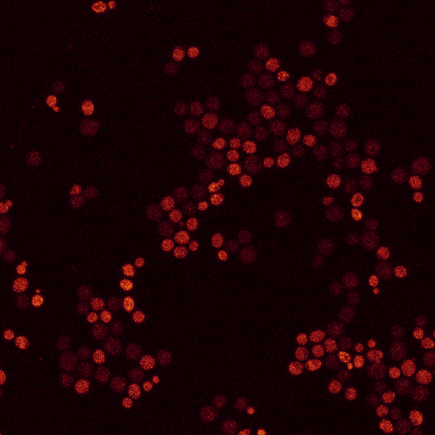
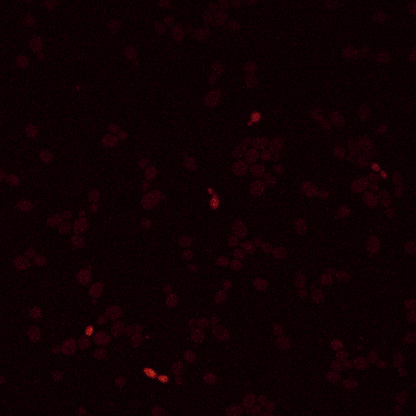
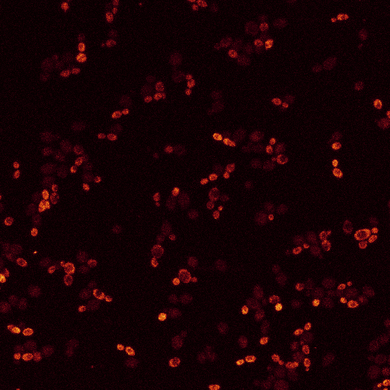
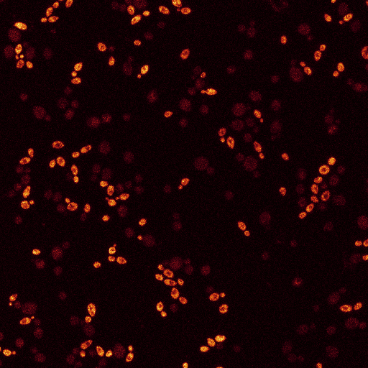
Evolution of yeast fluorescence with culture age
A9
Y275
24 hrs
48 hrs
72 hrs

Slide 4
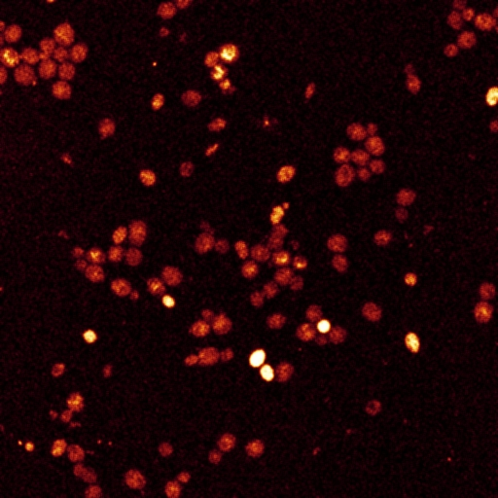
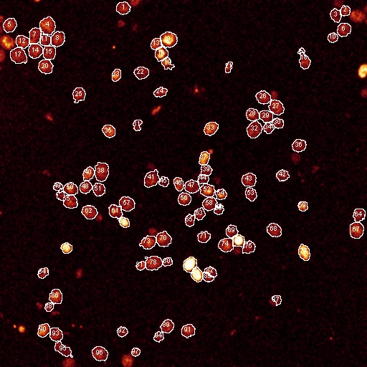

Capturing and quantifying heterogeneity (1)
Image analysis
  Extracting features (size, intensity, texture) using customized plugins for ImageJ*
*http://rsb.info.nih.gov/ij/

Slide 5
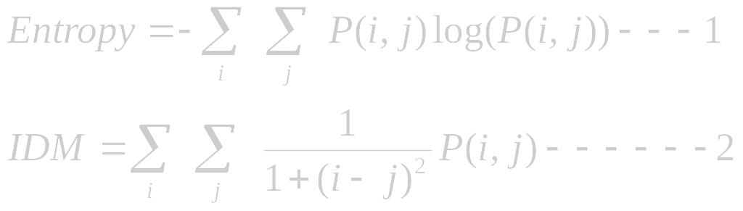
Definition of texture features
  Entropy
    A statistical measure of randomness that can be used to characterize the texture of input image
  Inverse difference moment (IDM)
    A measure of image texture with value ranging from 0 for highly textured image to 1 for untextured image
P(i,j) is defined as the matrix of relative frequencies with which two neighboring resolution cells separated by distance d occur on the image, one with gray tone i and the other with gray tone j

Slide 6
Evolution of yeast fluorescence with culture age
A9
Y275
24 hrs
48 hrs
72 hrs

Slide 7
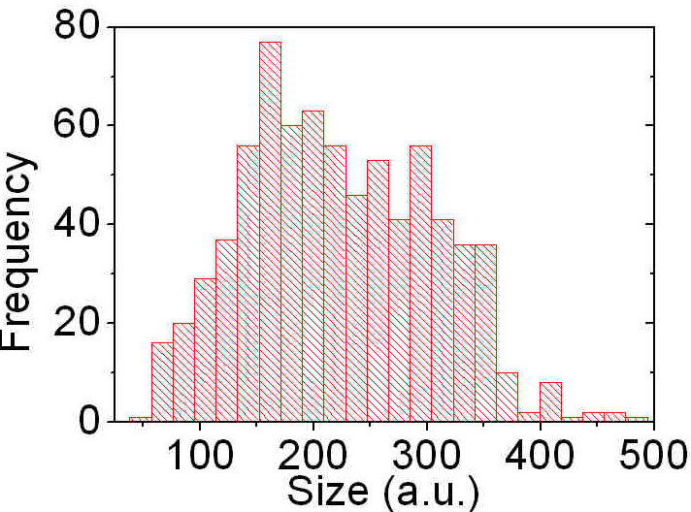
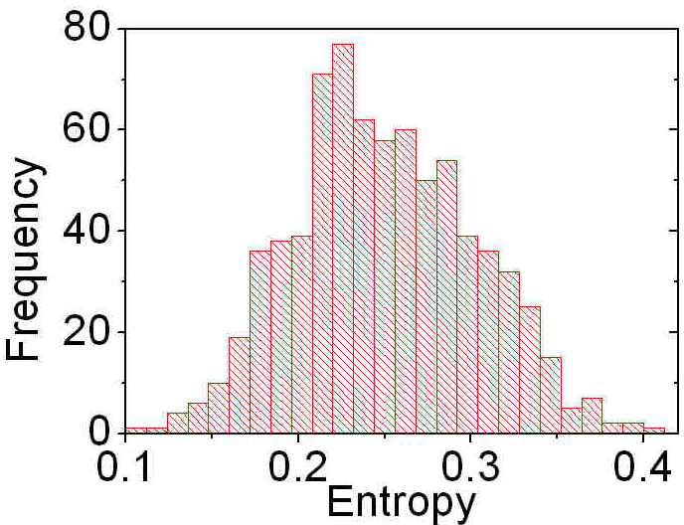
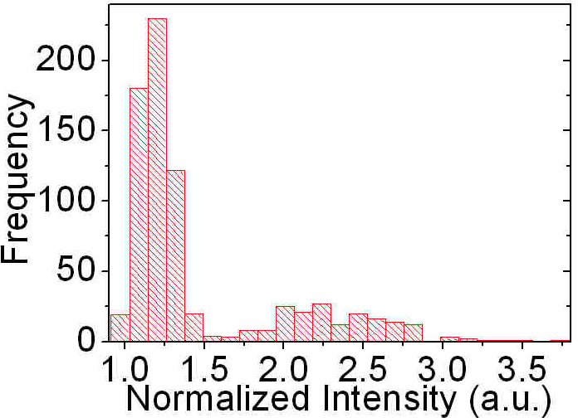
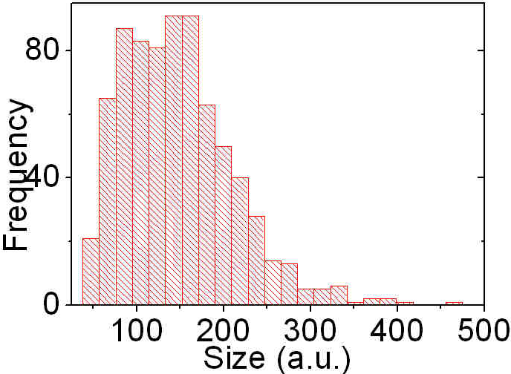
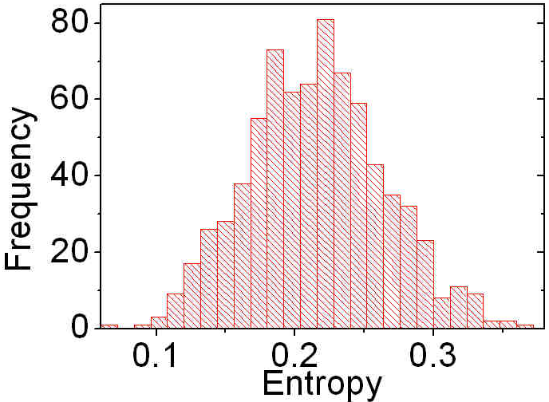
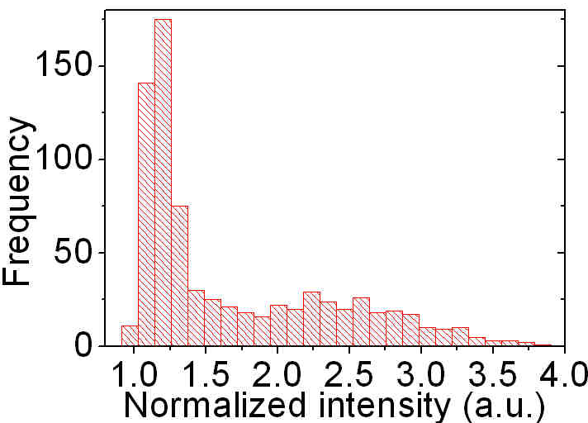
Histograms for cells at 48hrs
A9
Y275

Slide 8
Capturing and quantifying heterogeneity (2)
Statistical description
  Empirical cumulative distribution function (ecdf)
    ecdf(x₀)=fraction of population characterised by the relevant parameter x<x₀
Statistical analysis
  Kolmogorov-Smirnov test
    One of the most useful nonparametric tets for comparing two distributions

Slide 9
Materials and methods (1)
Cell culture
  Yeast strains (Saccharomyces cerevisiae) A9 (baking strain) and Y275 (brewing strain) grown in non-fluorescent medium
  Standardized inoculation, OD_{600nm =} 0.006 for starter culture
  Each strain cultured in two different flasks at room temperature (25⁰C), 3 images taken for each as reproducibility check

Slide 10
Materials and methods (2)
Microscopy of cells
  100 oil objectives were used
  Fluorescence emission and lifetime data collected at 440 – 540 nm for 405 nm excitation for cells grown for 24, 48 and 72 hrs (6 replicates)
  Fluorescence images were collected in z-stack of 10 slices then cell images with maximum intensity selected for analysis

Slide 11
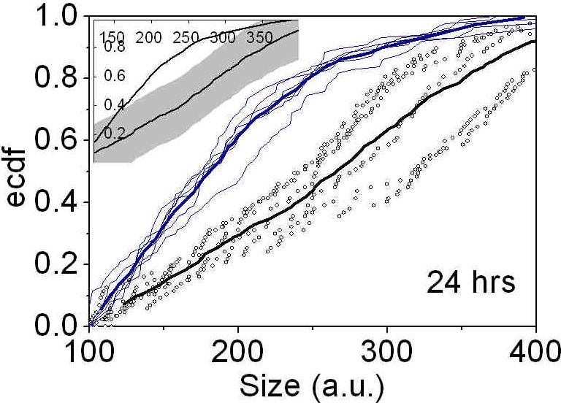
Analysis of cell size - ecdf and KS test
24 h culture
P=0.05
The cumulative distribution function for size of the yeast strain A9 (dots) and Y275 (line) at 24 hrs of age. Thick lines represent combined data for all six replicates.
Inset: ecdfs of combined data with the KS test band in grey.

Slide 12
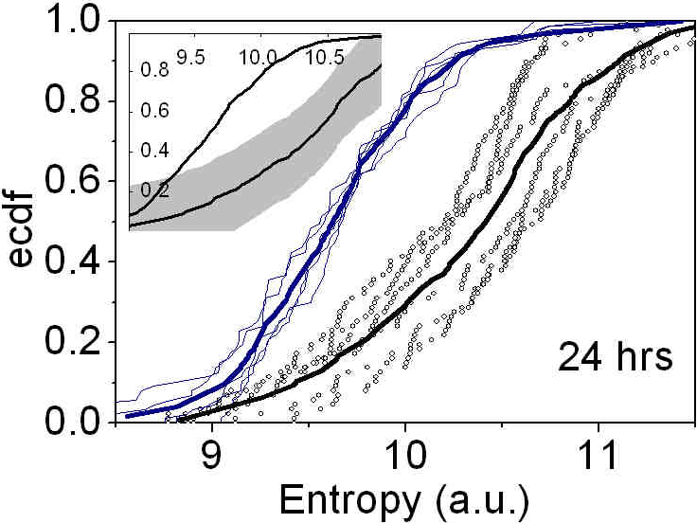
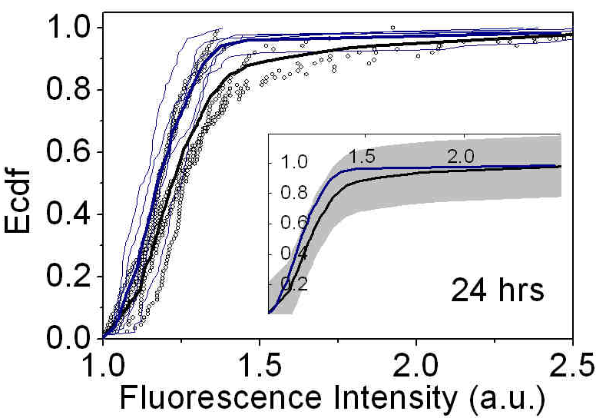
Analysis of entropy & intensity (24 hrs)
P=0.05
P=0.05
The cumulative distribution function for entropy and fluorescence intensity of the yeast strain A9 (dots) and Y275 (line) at 24 hrs of age. Thick lines represent combined data for all six replicates.
Inset: ecdfs of combined data with the KS test band in grey.

Slide 13
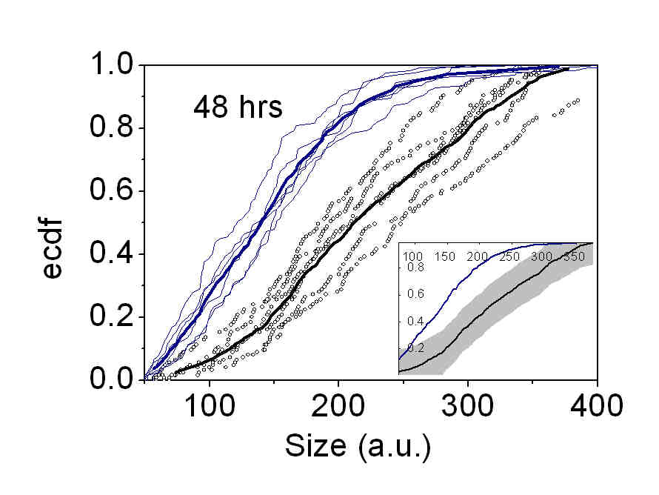
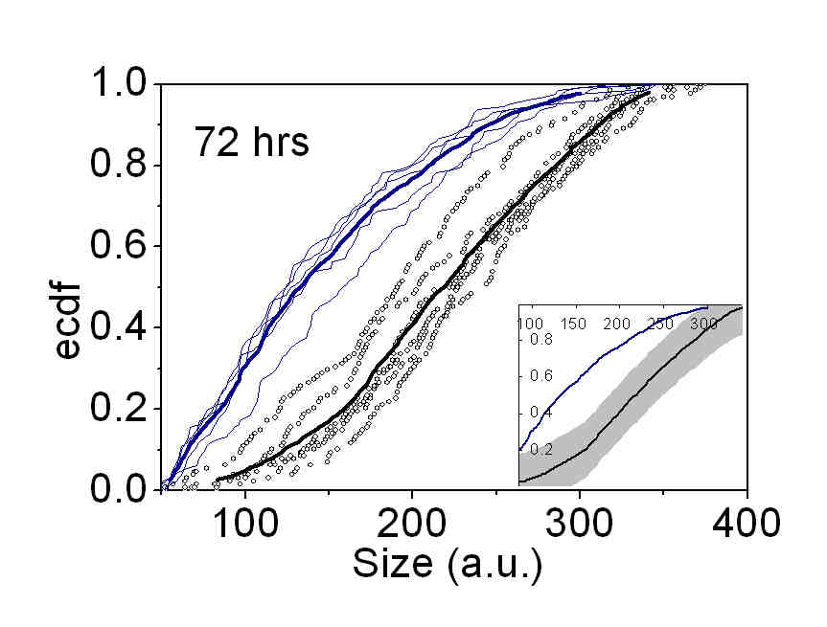
Size evolution with age
P=0.05
P=0.05
P=0.05

Slide 14
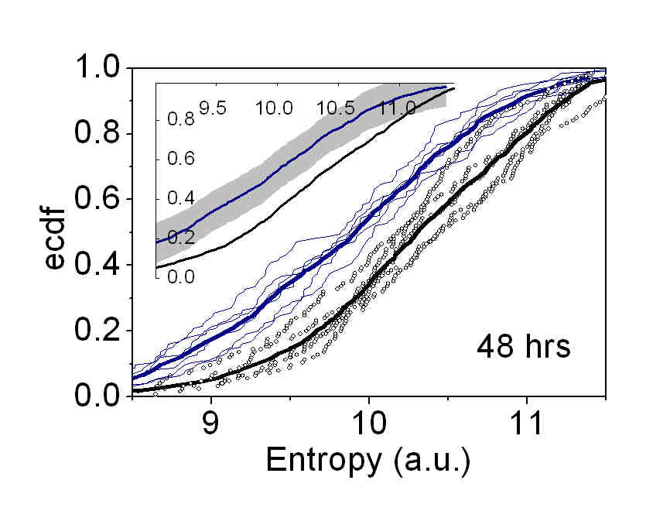
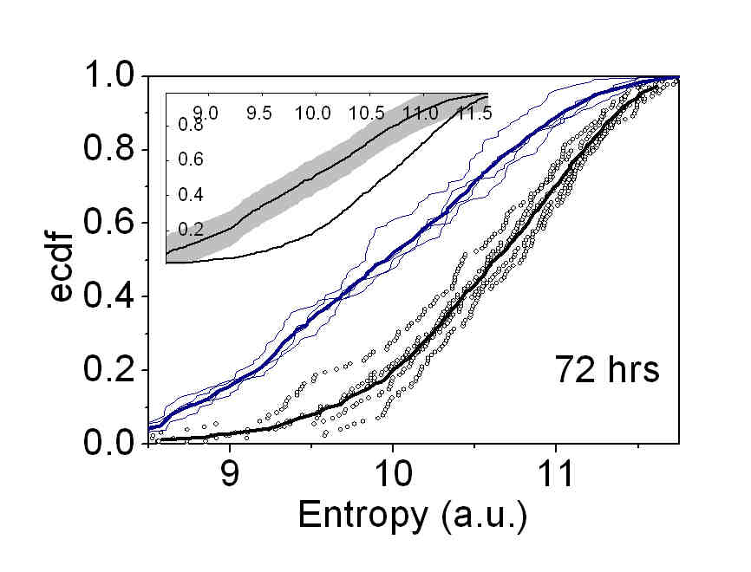
Entropy evolution with age
P=0.05
P=0.50
P=0.50
dots –A9, lines -Y275

Slide 15
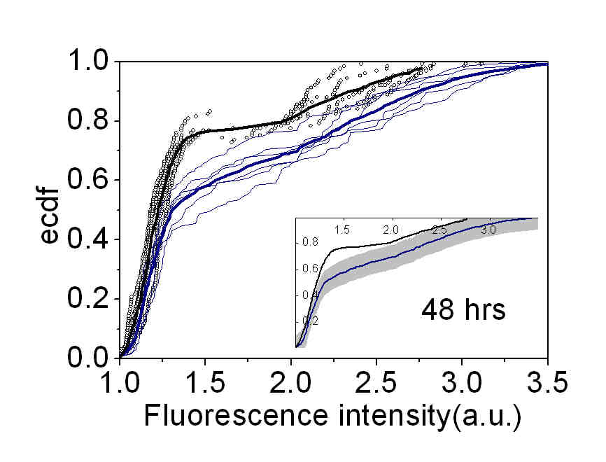
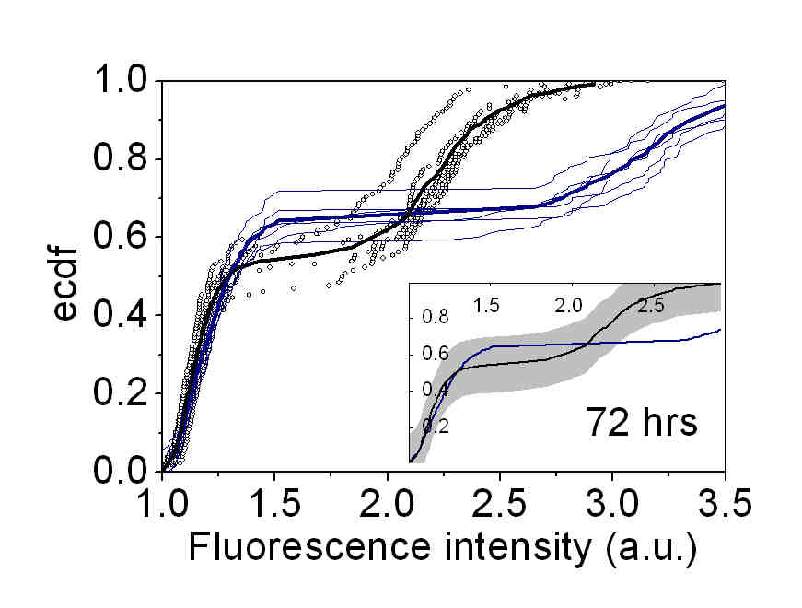
Intensity evolution with age
P=0.50
P=0.05
Dots – A9
Lines - Y275
P=0.05

Slide 16

Significance levels
Maximum distance (D) and probability (p) values for the k-s test applied to yeast images.
D1 is the maximum difference between combined ecdf and individual ecdfs of six replicates (1/2 width of grey stripe), p1 is relevant to intra-strain variability given in preceding column, n1 is the sample size for single data set of each strain, D2 is the maximum difference between combined ecdfs for two strains, p2 is relevant to intra-strain variability given in preceding column, n2 is the sample size for cumulative data set of each strain.

Slide 17
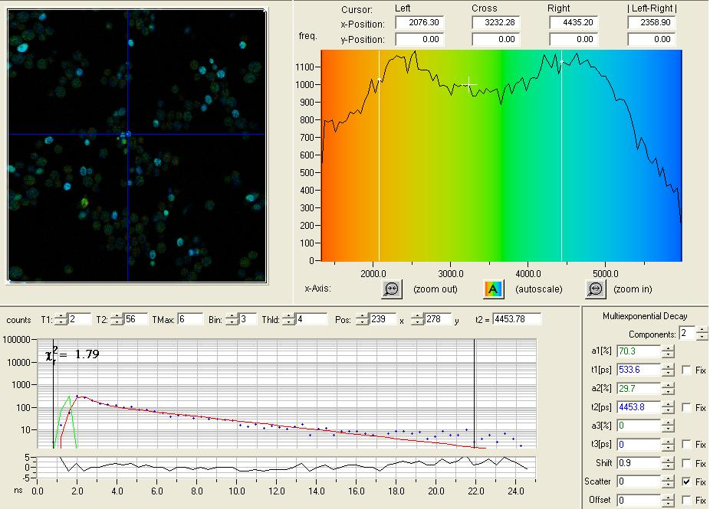
FLIM results
(a)
Color coded fluorescence lifetime image (a) , distribution of lifetimes (b)
and lifetime decay curve (c) of yeast strain A9 at 48 hrs of age.
(b)
(c)

Slide 18
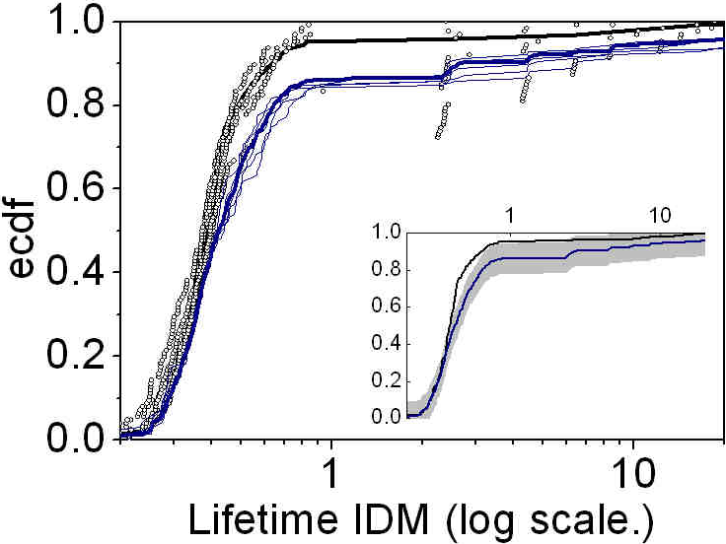
FLIM texture
P<0.001
for n=522
ecdf plot of inverse difference moment (IDM) for fluorescence lifetime of yeast strain A9 (dots) and Y275 (line) at 48 hrs of age.

Slide 19
Conclusions
We carried out detailed characterisation of yeast cell populations by fluorescence microscopy and FLIM
It is possible to distinguish the two examined yeast strains by population properties
Strain identities and differentiation demonstrated at acceptable confidence levels
A novel method for comprehensive characterization of yeast strains through data mining of microscopy images
Evolution of cell features with culture age examined.

